Slide 1
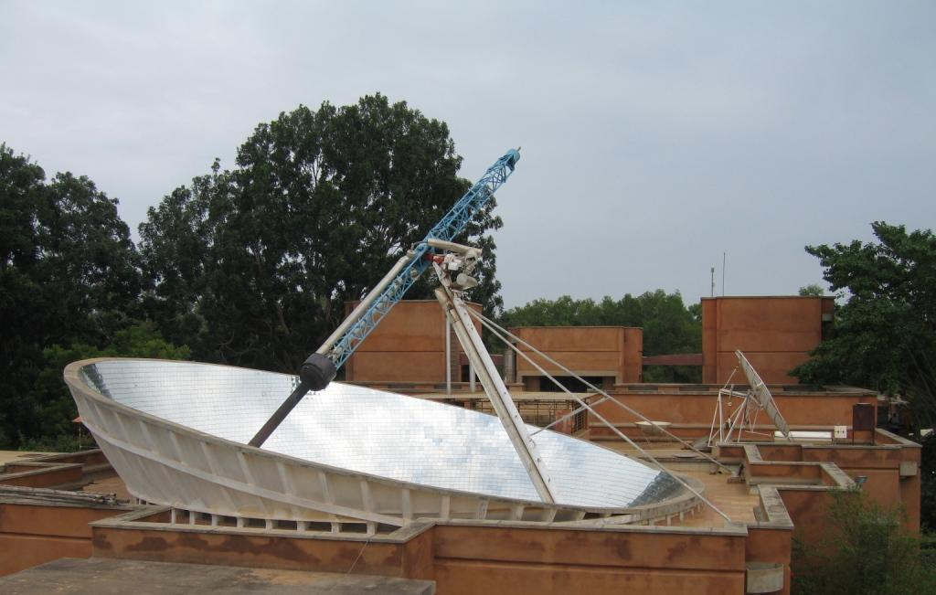
Energy Resources
Dr. Nikhil K. Kothurkar

Slide 2
Outline
Units and Terms
Energy Resources, Depletion and Risks
Environmentally Benign Forms of Energy
Efficiency Measures
Reduction in Consumption—Individual Perspective

Slide 3
Energy units
1.0 joule (J) = one Newton applied over a distance of one meter (= 1 kg m²/s²).
1.0 joule = 0.239 calories (cal)
1.0 calorie = 4.187 J
1.0 gigajoule (GJ) = 10⁹ joules = 0.948 million Btu = 239 million calories = 278 kWh
1.0 British thermal unit (Btu) = 1055 joules (1.055 kJ)
1.0 Quad = One quadrillion Btu (10¹⁵ Btu) = 1.055 exajoules (EJ), or approximately 172 million barrels of oil equivalent (boe)
1000 Btu/lb = 2.33 gigajoules per tonne (GJ/t)
1000 Btu/US gallon = 0.279 megajoules per liter (MJ/l)

Slide 4
Power Units
1.0 watt = 1.0 joule/second = 3.413 Btu/hr
1.0 kilowatt (kW) = 3413 Btu/hr = 1.341 horsepower
1.0 kilowatt-hour (kWh) = 3.6 MJ = 3413 Btu
1.0 horsepower (hp) = 550 foot-pounds per second = 2545 Btu per hour = 745.7 watts = 0.746 kW

Slide 5
Heating Value of a Fuel
Energy (heat) released per unit quantity (mass or volume) of a fuel upon combustion is called its heating value.
The lower heating value (LHV) is calculated with combustion products in the gas phase…more relevant for mobile applications
The higher heating value (HHV) is calculated after condensing the gaseous products (mostly water)...more relevant for stationary applications
Energy contents are expressed here as Lower Heating Value (LHV) unless otherwise stated (this is closest to the actual energy yield in most cases).
HHV> LHV by….depending mainly on the hydrogen content of the fuel.
5% (in the case of coal), 10% (for natural gas), 6-7% for biomass feedstocks

Slide 6
Fossil Fuels Units and Energy Content
1 Petroleum barrel = 42 U.S. gallons = 35 Imperial gallons = 159 L.
Barrel of oil equivalent (boe) = ~ 6.1 GJ = 5.8 million Btu = 1,700 kWh.
7.2 barrels oil are equivalent to 1 metric tonne of oil = 42-45 GJ.
gasoline density (average) = 0.73 g/ml ( = metric tonnes/m³)
Note that the energy content (heating value) of petroleum products per unit mass is fairly constant, but their density differs significantly – hence the energy content of a liter, gallon, etc. varies between gasoline, diesel, kerosene.

Slide 7
Fossil Fuels Units and Energy Content
Gasoline:
LHV = LHV115,000 Btu/US gallon = 121 MJ = 32 MJ/liter.
HHV= 125,000 Btu/US gallon = 132 MJ/gallon = 35 MJ/liter
1 Metric tonne gasoline = 8.53 barrels = 1356 liter = 43.5 GJ/t (LHV); 47.3 GJ/t (HHV)
Petro-diesel
Heating Value: 130,500 Btu/gallon (36.4 MJ/liter or 42.8 GJ/t)
petro-diesel density (average) = 0.84 g/ml (= metric tonnes/m³)

Slide 8
Fossil Fuels Units and Energy Content
Coal
Bituminous/anthracite (common for power plants): 27-30 GJ/metric tonne (11,500-13,000 Btu/lb);
Lignite/sub-bituminous: 15-19 GJ/metric tonne (6,500-8,200 Btu/lb)
Natural gas:
HHV = 1027 Btu/ft³ = 38.3 MJ/m³; LHV = 930 Btu/ft3 = 34.6 MJ/m³
1 Therm (used for natural gas, methane) = 100,000 Btu (= 105.5 MJ)

Slide 9
Carbon Content of Fuels
Coal (average) = 25.4 metric tonnes C/TJ
1.0 metric tonne coal = 746 kg carbon
Oil (average) = 19.9 metric tonnes C / TJ
1.0 US gallon gasoline (0.833 Imperial gallon, 3.79 liter) = 2.42 kg carbon
1.0 US gallon diesel/fuel oil (0.833 Imperial gallon, 3.79 liter) = 2.77 kg carbon
Natural gas (methane) = 14.4 metric tonnes C/TJ
1.0 cubic meter natural gas (methane) = 0.49 kg carbon
Carbon content of bioenergy feedstocks: approx. 50% for woody crops or wood waste; approx. 45% for graminaceous (grass) crops or agricultural residues.

Slide 10
Outline
Units and Terms
Energy Resources, Depletion and Risks
Environmentally Benign Forms of Energy
Efficiency Measures
Reduction in Consumption—Individual Perspective

Slide 11
Renewable and Nonrenewable Resources
Perpetual/Continuous resources are those that remain available in the same measure for an indefinitely long time e.g. Solar, Wind, Geothermal, Wave power
Renewable resources can be replenished over fairly short spans of time, such as months, years or decades. E.g. Biomass energy, biofuels, Hydroelectric power generation
Nonrenewable resources take millions of years to form and accumulate, e.g. All fossil fuels like coal, oil, natural gas; uranium, thorium (nuclear fuel)

Slide 12
Why do we have a Global Energy Crisis?
Humanity has a near total dependence on fossil fuels and other unsustainable energy sources for its needs.
Hence, energy use causes irreversible damage to Earth’s ‘life support system’.
Consequent global climate change, environmental pollution, health problems...
The known sources of energy incl. oil, gas, coal and nuclear fuel are exhaustible (some already severely depleted)
Energy consumption is increasing at an alarming rate—worsening the social and environmental impacts and accelerating depletion.
Shares of most renewable energy forms are presently very low; technological, commercial and policy barriers exist.

Slide 13
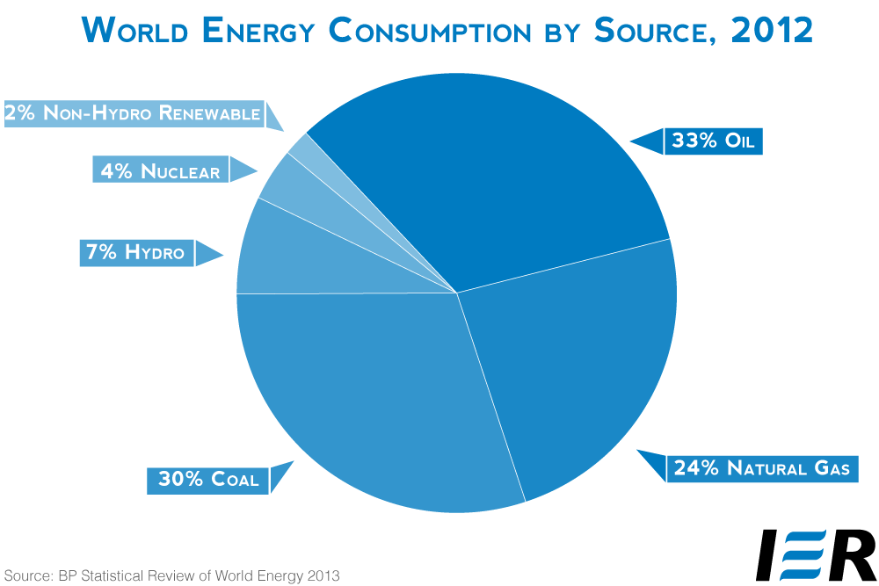
Major Dependence on Fossil Fuels: 87%
http://instituteforenergyresearch.org/analysis/statistical-review-of-world-energy-2013-viva-la-shale-revolucion/

Slide 14
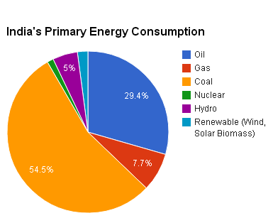
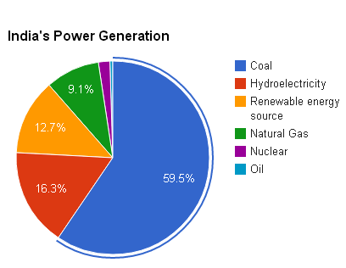
India’s Energy Consumption
Major Dependence on Fossil Fuels: 91%
http://en.wikipedia.org/wiki/Energy_policy_of_India#Power_Generation_capacity_in_India

Slide 15
Electricity in India
Overall electrification rate: 64.5%
35.5% of the population without access to electricity.
Urban: access to electricity is 93.1% (2008).
Rural:
80% of Indian villages have an electricity line
52.5% of rural households have access to electricity.
http://en.wikipedia.org/wiki/Electricity_sector_in_India

Slide 16
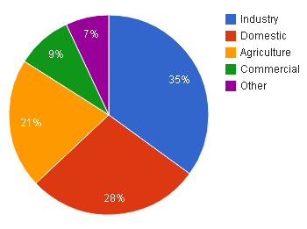
India’s Electricity Use

Slide 17
India Electricity Deficit
For 2014–15
Installed capacity of 258.7 GW (Jan 2014).
Avg. base load energy deficit = 5.1%
12% in S
17.4% in NE)
Peaking shortage = 2%
22.2% in S
12% in NE
http://en.wikipedia.org/wiki/Electricity_sector_in_India

Slide 18
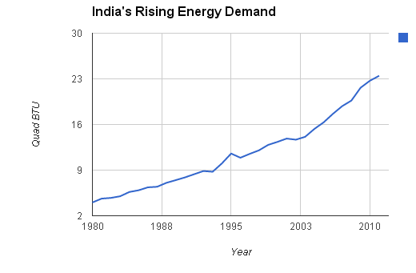
Rising Demand
http://www.indexmundi.com/energy.aspx?country=in&product=total-primary-energy&graph=consumption

Slide 19
Depleting Sources
Fossil Fuels (oil, coal, gas):
Non-renewable.
Oil depleting rapidly. Peak oil
Coal: Mining is leading to deforestation and habitat loss.
Nuclear:
Uranium depleting rapidly
Thorium will last somewhat longer
Reprocessing can “create” fuel and make it last much longer.
Fusion technology is still distant.
Hydropower:
Most major river systems have been dammed.
Additional major projects might not be possible due to limited resource and pressure from activists.

Slide 20
But we cannot even consume all the remaining fossil fuels.
The socio-environmental costs of exhausting all the fossil reserves are extremely serious...

Slide 21
Risks and Costs of Energy Sources
Fossil Fuels (oil, coal, gas):
Greenhouse Gas Emissions, Climate change.
Pollution of air, land and water.
Nuclear:
Major accidents, minor accidental releases of radioactive materials
Nuclear waste problem.
Unaccounted costs of decommissioning and cleanup.
Hydropower:
Large land submergence, loss of habitat,
Disruption of riverine ecosystems and floodplain agriculture,
Uncompensated oustees, major public agitations.

Slide 22
An Overwiew of Fossil fuels
Fossil fuels are hydrocarbons that may be used as a fuel found within the top layer of the Earth’s crust.
Coal, oil and gas are called "fossil fuels" because they have been formed from the organic remains of prehistoric plants and animals
Coal is crushed to a fine dust and burnt.
Oil and gas can be burnt directly.

Slide 23
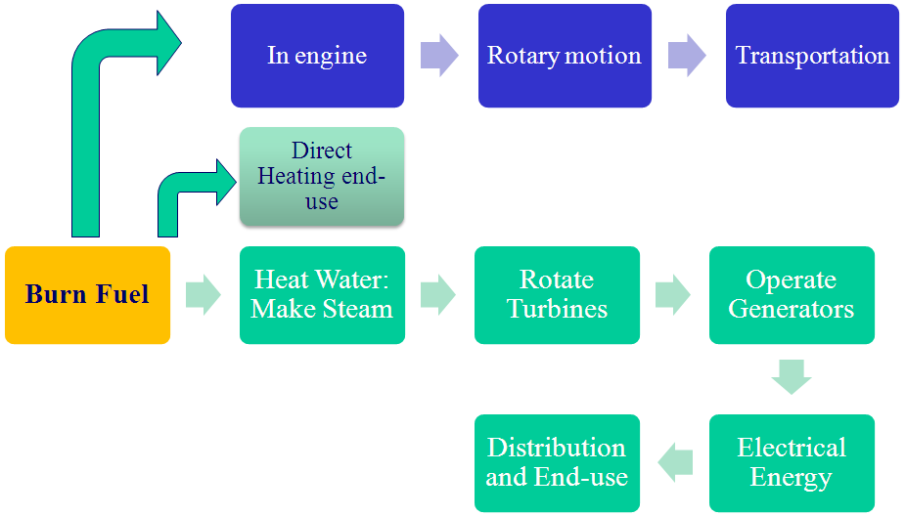
How it works

Slide 24
Advantages of Fossil Fuels
Very large amounts of electricity can be generated in one place using coal, fairly cheaply.
Transporting oil and gas to the power stations is easy.
Gas-fired power stations are very efficient.
A fossil-fuelled power station can be built almost anywhere, so long as you can get large quantities of fuel to it

Slide 25
How do we get fossil fuels?
Petroleum and natural gas—oil wells
Coal—mining

Slide 26
Petroleum and Natural Gas Extraction
Crude oil (called "petroleum") is easier to get out of the ground than coal, as it can flow along pipes. This also makes it cheaper to transport
Natural gas provides around 20% of the world's consumption of energy, and as well as being burnt in power stations, is used by many people to heat their homes.
It is easy to transport along pipes, and gas power stations produce comparatively little pollution

Slide 27
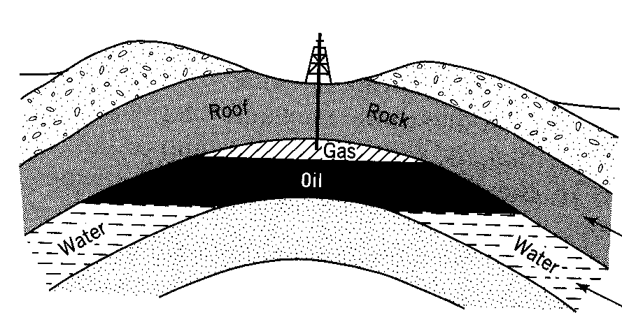
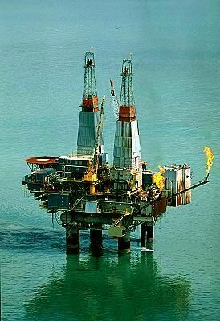
Petroleum and Natural Gas Extraction
Oil Drilling Platform
Cook Inlet, Alaska
an average well in the US produces only 11 barrels / day
In Saudi Arabia an average produces 9600 barrels /day well

Slide 28
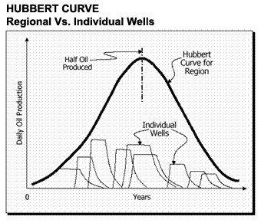

Slide 29
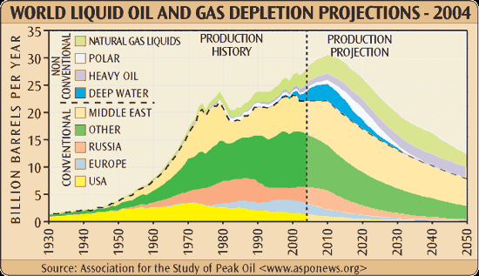

Slide 30
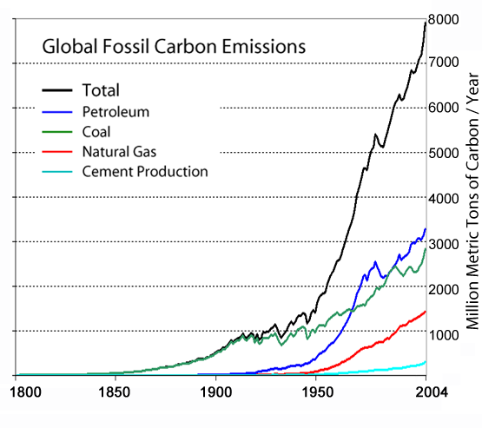
Massive Increase in Fossil Fuel Use and CO₂ emissions.

Slide 31
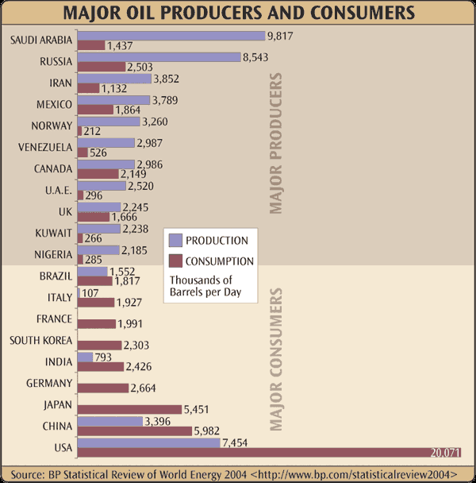

Slide 32
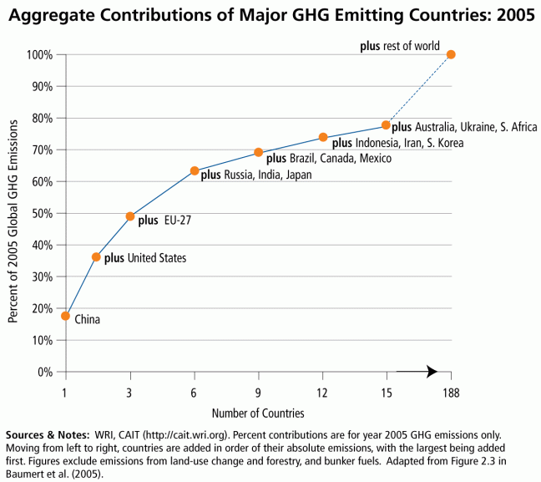
Aggregate Contributions of Major GHG Emitting Countries: 2005
http://www.wri.org/resources/charts-graphs/aggregate-contributions-major-ghg-emitting-countries-2005

Slide 33
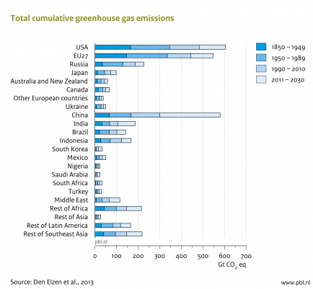
Country-Wise Total Cumulative GHG Emissions
http://www.pbl.nl/en/publications/countries-contributions-to-climate-change

Slide 34
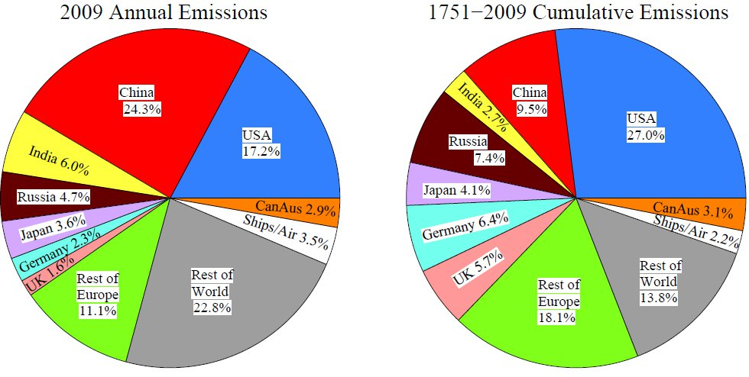
GHG Emissions Countries
http://www.resilience.org/stories/2010-12-09/china-can-slow-global-warming-if-us-won%E2%80%99t

Slide 35
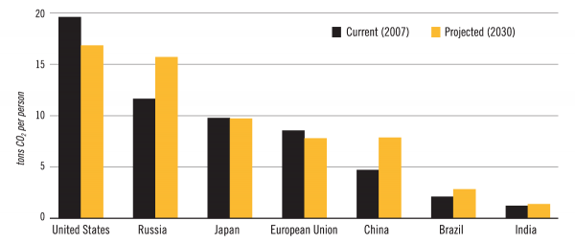
Country-Wise Per Capita CO₂ Emissions

Slide 36
If OIL is running out, why not use COAL?
Surely, there’s plenty of it.

Slide 37
Advantages of Coal
World reserves are relatively more plentiful
Technology is old and established
High energy content.
Solid fuel is easy to transport.
New technologies such as clean coal technology, gasification, reforming etc. are coming up.

Slide 38
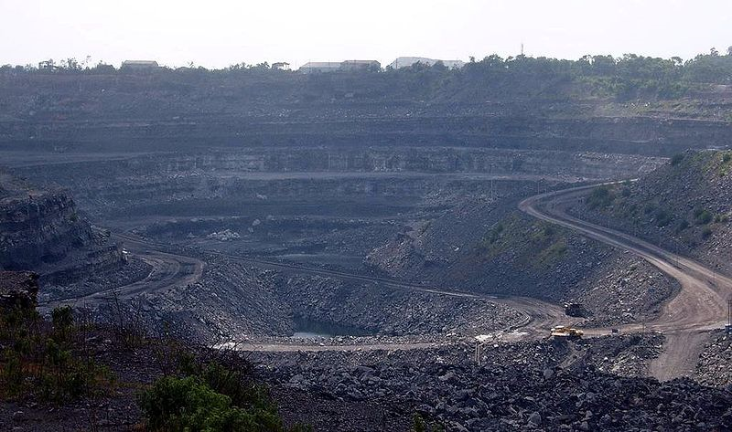
Coal Mining
A coal mine in Bihar, India.

Slide 39
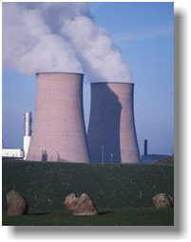
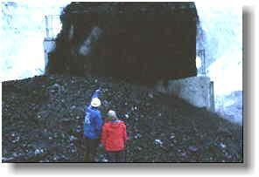
Emission of gases

Slide 40
Disadvantages of coal
Being a C-based fuel, causes greenhouse emissions. Coal is the largest contributor to the human-made increase of CO₂ in the air.
Will run out in 56 years (in 2065) if current acceleration in its use continues.
Extensive land degradation and pollution due to mining.
100s of mi. tons of waste products (fly ash, bottom ash, flue gas desulfurization sludge) containing mercury, uranium, thorium, arsenic, and other heavy metals
Acid rain from high sulfur coal
Interference with groundwater and water table levels
http://en.wikipedia.org/wiki/Coal#Environmental_effects

Slide 41
Disadvantages of coal
Contamination of land and waterways and destruction of homes from fly ash spills.
Dust nuisance
Coal-fired power plants without effective fly ash capture are one of the largest sources of human-caused background radiation exposure
Diseases caused by coal-fired power plants~24,000 lives/yr in USA

Slide 42
Methods to control the pollution
Clean coal technology to burn coal more efficiently and will lesser toxic pollutants emitted.
Flue gas desulphurisation: removes the acid rain-producing sulphur oxides from the flue gas
Yet combustion of coal invariably leads to CO₂ emissions and global warming

Slide 43
Alright, coal looks quite awful.
But what about Natural Gas?
That’s supposed to be pretty clean, right?

Slide 44
Natural Gas
Natural gas (mostly CH₄) is more potent as a greenhouse gas than its combustion product, CO₂.
Was once wasted during oil drilling.
Often simply flared from an oil well.
More recently it has been put to use.
Methane does not get liquefied upon compression at room temperature: CNG is used in public transportation and private vehicles.

Slide 45
Natural Gas
Low energy density
Burns cleaner than petrol/diesel.
NO_{x} emissions continue to remain a problem.
World gas reserves: Will last 60 yrs. at current rate of consumption.—Dr. Anthony Hayward CCMI, chief executive of BP 2009.

Slide 46
Effects of Fossil fuels
Global warming and climate change due to emissions from burning
Mining, extraction and refining processes are themselves highly energy consuming, and polluting and disrupt human and natural habitats in the vicinity.
Reduced biodiversity due to impacts on environment.
Adverse effects on land surface and groundwater.
Contamination of water bodies, heavy toll on marine ecosystems, due to pollution and oil spills

Slide 47
OK, forget about Fossil Fuels. They all seem bad.
Let’s GO NUCLEAR!
Enormous quantities of cheap energy with no emissions!

Slide 48
Nuclear Energy
Nuclear Energy is energy released due to the splitting (fission) or merging together (fusion) of the nuclei of atom(s).
Nuclear power is most commonly generated using uranium, which is a metal mined in various parts of the world.
Some military ships and submarines have nuclear power plants for engines

Slide 49
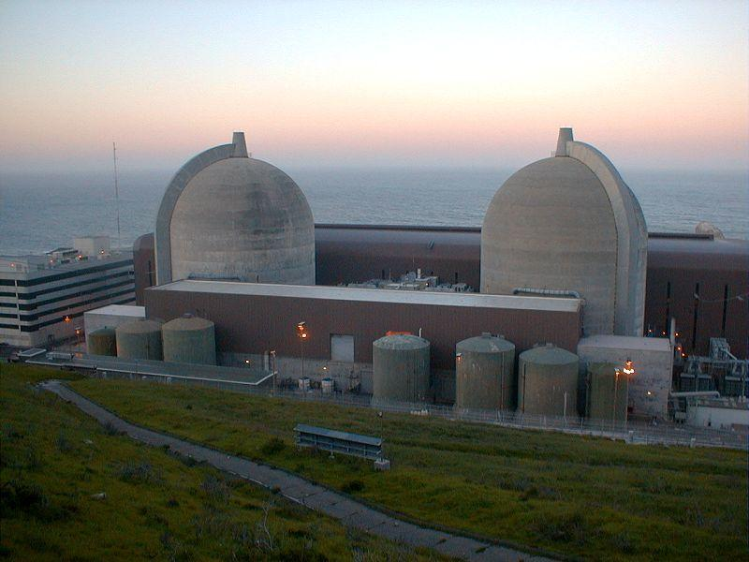
Nuclear Energy
Nuclear power: 4-largest source of electricity in India.
As of 2010, India has 19 nuclear power plants in operation generating 4,560 MW while
4 others under construction and are expected to generate an additional 2,720 MW.
In France 79% of electricity comes from nuclear reactors
Nuclear power Diablo Canyon - California

Slide 50
Advantages
Nuclear power costs about the same as coal, so it's not expensive to make.
Does not produce smoke or carbon dioxide, so it does not contribute to the greenhouse effect.
Produces huge amounts of energy from small amounts of fuel.
Produces small amounts of waste.
Nuclear power is reliable.

Slide 51
Disadvantages
It can be extremely dangerous.
Nuclear power is reliable, but a lot of money has to be spent on safety - if it does go wrong, a nuclear accident can be a major disaster.
Small quantities of spent fuel wastes: huge disposal issue.
Serious inter-generational ethical issues exist.
“Nuclear power, which for some countries plays a strategic role in energy security, faces an uncertain future.”--World Energy Outlook 2014

Slide 52
Come on, the safety issue is exaggerated!
Don’t nuclear power plants follow strict safety regulations?
Accidents, if at all might have happened in the past and that too in only in the Soviet Union.

Slide 53
International Nuclear Event Scale
7 – Major Accident
6 – Serious Accident
5 – Accident With Wider Consequences
4 – Accident With Local Consequences
3 – Serious Incident
2 – Incident
1 – Anomaly
0 – Deviation (No Safety Significance)

Slide 54
Nuclear Accidents Worldwide
Event Scale | Designation | Example
7 | Major Accident | Fukushima Daiichi nuclear disaster (2011), Chernobyl disaster, 26/4/1986. 56 dead; 4,000 cancer fatalities, 600,000 exposed to elevated doses of radiation.
6 | Serious Accident | Kyshtym disaster at Mayak, Soviet Union, 29/9/1957. 70-80 tons of highly radioactive material into the environment. Impact on local population is not fully known.
5 | Accident With Wider Consequences | Windscale fire (UK), 10/10/1957. Radionuclide released , 200-240 thyroid cancer cases expected. Three Mile Island accident (US), 28/3/1979Some radioactive gases were released into the atmosphere. Goiânia accident (Brazil), 13/9/1987. An unsecured caesium chloride radiation source left in an abandoned hospital was recovered by squatters unaware of its nature and sold at a scrapyard. 249 people contaminated; 4 died.

Slide 55
Nuclear Accidents Worldwide
Event Scale | Designation | Example
4 | Accident With Local Consequences | Sellafield (United Kingdom) - 5 incidents 1955 to 1979[3] SL-1 Experimental Power Station (United States) - 1961, reactor reached prompt criticality, killing three operators Saint-Laurent Nuclear Power Plant (France) - 1980, partial core meltdown Buenos Aires (Argentina) - 1983, criticality accident during fuel rod rearrangement killed one operator and injured 2 others Jaslovské Bohunice (Czechoslovakia) - 1977, contamination of reactor building Tokaimura nuclear accident (Japan) - 1999, three inexperienced operators at a reprocessing facility caused a criticality accident; two of them died

Slide 56
Nuclear Accidents Worldwide
Worldwide 99 accidents at nuclear power plants.
Of which 57 occurred since the Chernobyl disaster
57% (56 out of 99) occurred in the USA.^{[7]}
Serious nuclear power plant accidents include:
the Fukushima Daiichi nuclear disaster (2011),
Chernobyl disaster (1986),
Three Mile Island accident (1979)
SL-1 accident (1961).^{[8]}
Highest cumulative loss among energy-related accidents.
The French Atomic Energy Commission (CEA) has concluded that technical innovation cannot eliminate the risk of human errors in nuclear plant operation.
http://en.wikipedia.org/wiki/Nuclear_and_radiation_accidents

Slide 57
99 nuclear reactor accidents world-wide is not a big deal! It shows how safe the technology is!
Auto accidents happen in millions.

Slide 58
Radioactivity-related accidents/leaks can lay waste contaminated land for thousands of years.
Immediate deaths (which are very few) are not the best way of quantifying damage.
Affects exposed persons and future generations (mutations, birth defects).

Slide 59
Radioactive Waste Disposal
The cumul. total of spent nuclear fuel > 700,000 tonnes.
Radioactive wastes can remain a concern for thousands of years and several half-lives.
Long term and inter-generational health impacts should be examined critically.
Practical studies only consider up to 100 years as far as effective planning and cost evaluations are concerned.
To date, no country has opened a permanent disposal facility to isolate the most long-lived and highly radioactive waste produced by commercial reactors--World Energy Outlook 2014
If safe disposal as promised by various governments and nuclear agencies is so easy then why did they do this...?

Slide 60
Illegal Dumping—Mafia
‘Ndrangheta mafia clan accused of trafficking and illegally dumping nuclear waste.
A manager of the Italy’s state energy research agency “Enea” paid the clan to get rid of 600 drums of toxic and radioactive waste from Italy, Switzerland, France, Germany, and the US, with Somalia as the destination, where the waste was buried after buying off local politicians.
Enea employees are suspected of paying the criminals to take waste off their hands in the 1980s and 1990s.
Ndrangheta claim to have been paid to sink ships with radioactive material for the last 20 years.
http://en.wikipedia.org/wiki/Toxic_waste_dumping_by_the_%27Ndrangheta

Slide 61
Reading Material:
Pros and Cons of the Nuclear Energy Debate.
Whole Earth Discipline (pro-nuclear)
Four Nuclear Myths: A Commentary on Stewart Brand's Whole Earth Discipline and on Similar Writings (pro-renewables)

Slide 62
OK, just stop!
Let’s not get into a debate...
What about plain and simple Hydroelectric Power?
There couldn't possibly be any problem with it!

Slide 63
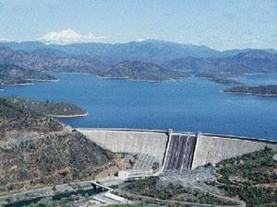
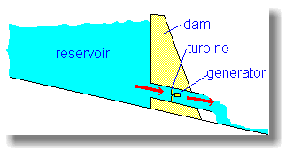
Water generated – Hydroelectric
Shasta dam in California

Slide 64
Hydroelectric Power: Advantages
Low running costs
No waste or pollution.
High reliability, continuous generation.
Electricity can be generated constantly
Easy to step up or step down generation to meet peak demand.
Allied benefits related to creation of reservoirs such as irrigation, flood control, recreation.

Slide 65
Hydroelectric Power: Disadvantages
High initial costs
Huge areas submerged: displacement of thousands of people and habitat destruction.
Deforestation in the catchment
Loss of fertile riverbed land in catchment
Loss of fertile land downstream due to water logging
Greenhouse gas emissions from submerged and waterlogged land

Slide 66
Secure Energy Systems
“The foundation of a secure energy system is:
to need less energy in the first place,
Then to get it from sources that are inherently invulnerable because they're diverse, dispersed, renewable, and mainly local.
Any highly centralised energy system -- pipelines, nuclear plants, refineries -- invite devastating attack. But invulnerable alternatives don't, and can't, fail on a large scale.”
--Amory Bloch Lovins (physicist, environmental scientist, writer, and Chairman/Chief Scientist of the Rocky Mountain Institute.)

Slide 67
Well…then it looks like we cannot depend on any of the conventional energy sources.
But there are alternative forms of energy right?
Why can't we use them?

Slide 68
Outline
Units and Terms
Energy Resources, Depletion and Risks
Environmentally Benign Forms of Energy
Efficiency Measures
Reduction in Consumption—Individual Perspective

Slide 69
Alternative Energy: Good News
The continuous/renewable energy resources on Earth far exceed present human needs.
In general, we have the technology to harness them.
But some gaps exist...
That's where there is a tremendous scope for R&D and huge potential markets!

Slide 70
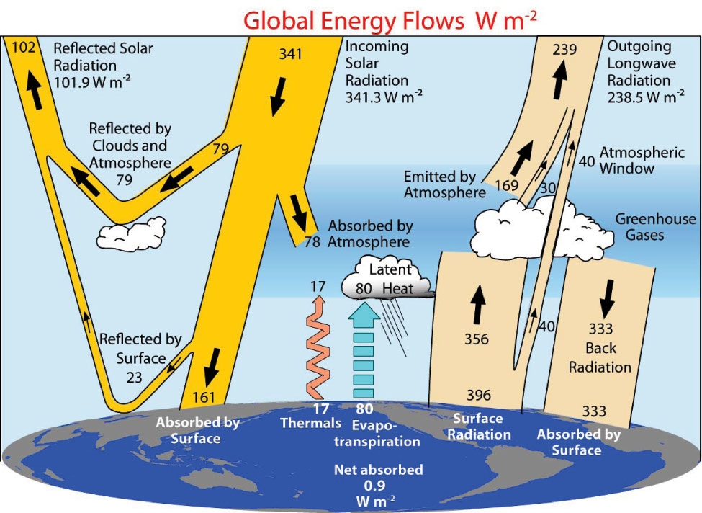
http://www.nar.ucar.edu/2008/ESSL/catalog/cgd/images/trenberth9.jpg

Slide 71
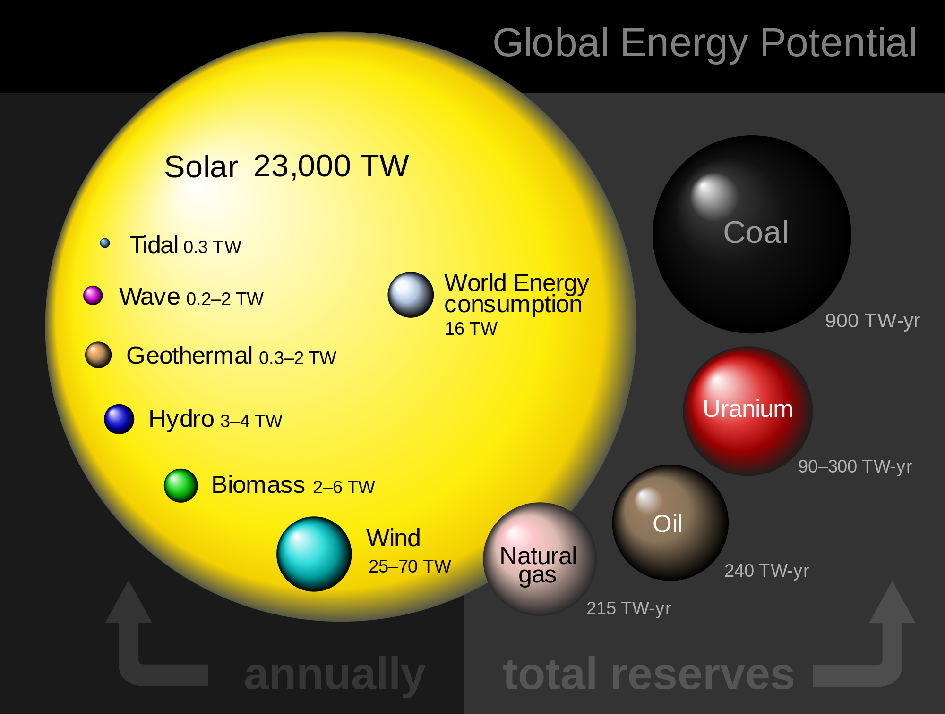

Slide 72
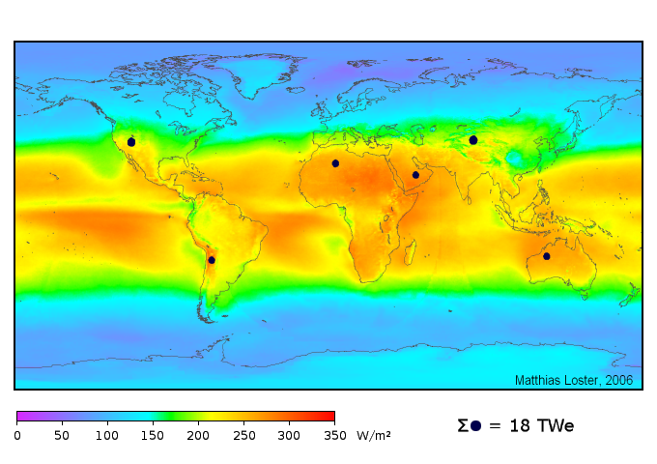
We have Enough Renewable Energy!
All human energy and fuel needs, supplied by black spots of solar cell areas
At conversion efficiency of 8%; cloud cover accounted for.
Colors show the local solar irradiance averaged over three years from 1991 to 1993 (24 hours a day)
http://www.ez2c.de/ml/solar_land_area/

Slide 73
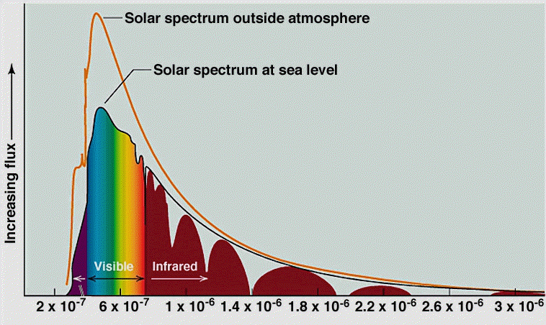
The Solar Spectrum
Notes:
This is the Solar Spectrum. The graph shows the flux of photons that come down to the Earth vs. the wavelength of the photons. The Orange line represents the solar spectrum outside the atmosphere. The spectrum reaches a peak in the visible as expected from black body radiation at 5800K (the surface temperature of the sun). The missing regions of flux (black line) at the earth’s surface are due to absorption from water vapor and carbon dioxide. As you can clearly see, the solar energy is not just a single energy (wavelength or frequency of light). If it were, we would have solar cells based on current technology with efficiencies over 95%. So why do we lose energy at different wavelengths? Part of it is because we are not absorbing the whole spectrum of a single photon. If we put in photons with larger energies than the bandgap we only capture the energy equal to Eg – we lose the rest to waste heat. Photons with energies lower than the bandgap do not contribute to carriers (electrons and holes) in a solar cell.
Source: http://ess.geology.ufl.edu/ess/Notes/040-Sun/spectrum.GIF

Slide 74
Applications of Solar Energy
Heating and cooling of residential building.
Solar water heating.
Solar cookers
Solar engines for water pumping.
Food refrigeration
Solar furnaces
Solar electric power generation by solar ponds, reflectors with lenses.
solar photovoltaic cells, which can be used for conversion of solar energy directly into electricity.

Slide 75
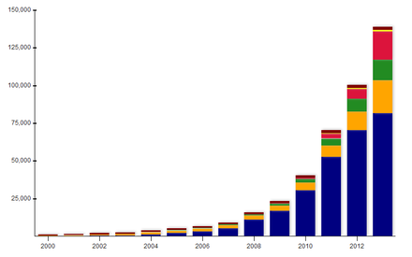
Worldwide Growth of PV
Europe
Asia-Pacific
Americas
China
Middle East and Africa
Rest of the World
http://en.wikipedia.org/wiki/Solar_energy

Slide 76
Overcoming Disadvantages (Solar)
Solar energy is available intermittently: dependent on weather conditions and the time of day
Luckily, large amount of energy demand is during daytime.
Grid-connected solar systems are most convenient.
During the night and cloudy days, traditional methods (fossil/nuclear/hydel) can be used to supply power to the grid.
Minimize the need to store the energy. The consumer can save battery costs (~ 50% of PV system costs).
It will greatly decrease our dependence on fossil fuels.
Enables private investment in the nation's energy infrastructure.
Captive energy for the consumer (individual/ organization)
Feed-in tariffs/net metering can enable the consumer to sell extra power generated.

Slide 77
Overcoming Disadvantages (Solar)
Grid connected solar systems have some challenges
Most states do not allow grid connected solar with feed-in tariffs/ net metering.
The grid in many countries including India, is unreliable and subject to frequent and extended blackouts and brownouts.
Adequate studies and governing standards and mechanisms for ensuring reliability and power quality of grids connected to numerous distributed micro-generation units are missing.

Slide 78
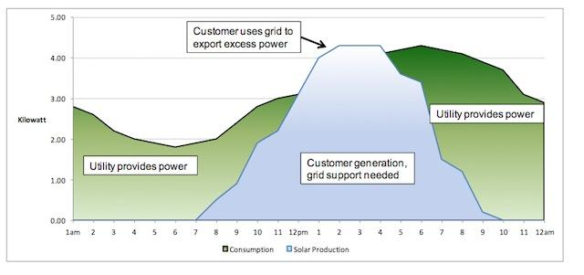
Net Metering
http://blogs-images.forbes.com/jamesconca/files/2014/11/SolarGrid.jpg

Slide 79
Overcoming High Cost (Solar)
High initial cost of solar cells
Coal electricity costs $0.08-0.20 cents/kWh,
PV electricity costs $0.50-1.00/kWh.
Fossil fuel energy costs do not include the socio-environmental costs.
If all costs are internalized, solar might easily be a winner.
Cheaper PV cells are available. Conversion efficiency is intimately tied to cost.
Crystalline Si and multijunction cells-- more efficient, more expensive
Amorphous Si--low efficiency but cheap.

Slide 80
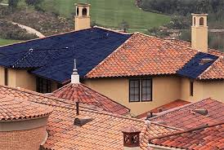
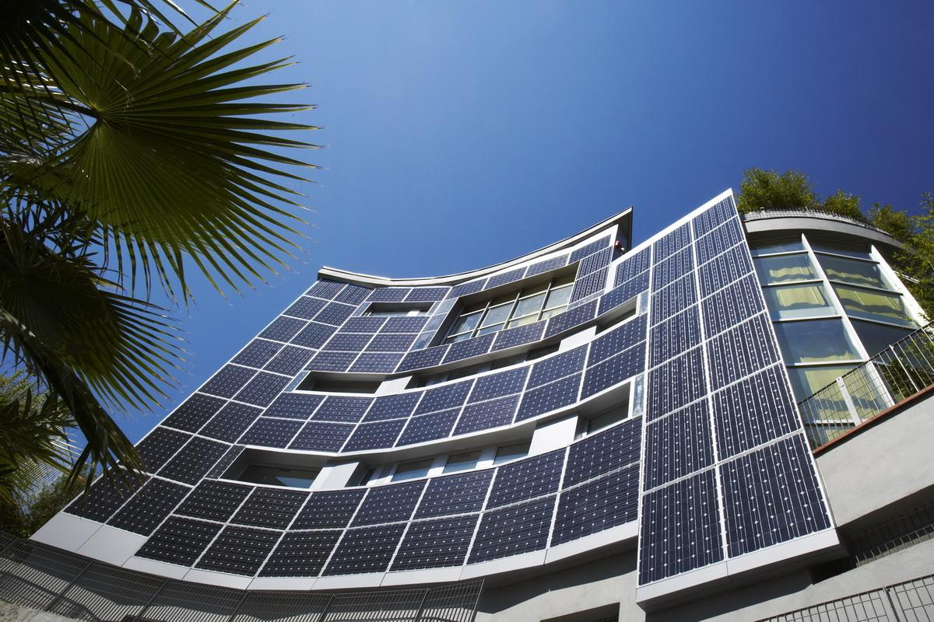
Building Integrated Photovoltaics (BIPV)
http://www.google.co.in/imgres?imgurl=http://media.treehugger.com/assets/images/2011/10/20090421-building-integrated-solar-tiles.jpg&imgrefurl=http://www.treehugger.com/renewable-energy/srs-energy-launches-building-integrated-photovoltaic-panels-for-clay-tile-roofs.html&h=315&w=468&tbnid=T0EGjVO6G6wA2M:&zoom=1&docid=TVp_PrG4vGc-uM&ei=K_gSVdmXC9OQuATl3oKoAg&tbm=isch&ved=0CEsQMyglMCU
http://www.google.co.in/imgres?imgurl=http://lightbysolar.co.uk/wp-content/uploads/2014/07/bipv-1.jpg&imgrefurl=http://lightbysolar.co.uk/building-integrated-photovoltaics/&h=800&w=1200&tbnid=CYtiuXAIUHtKQM:&zoom=1&docid=meqc4QGMX5haHM&ei=K_gSVdmXC9OQuATl3oKoAg&tbm=isch&ved=0CEwQMygmMCY

Slide 81
Overcoming Low Efficiency (Solar)
Overall efficiency of most PV systems can be is about 10-14%.
Some new ideas promise to be disruptive innovations (drastically more advantageous):
Solar thermal, with cogeneration (solar energy utilization >60%)
Concentrated photovoltaics, with heat recovery (solar energy utilization > 72%)
Watch Video: Solar Co-Generation

Slide 82
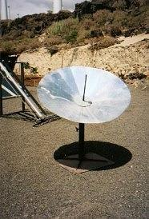
Overcoming Disadvantages (Solar)
Solar energy is a diffuse source. (low energy density).
To harness it especially in the form of heat, we can concentrate it.
Solar panels can be integrated into building roofs or other surfaces so that multiple functions can be served.
Solar reflector used for cooking

Slide 83
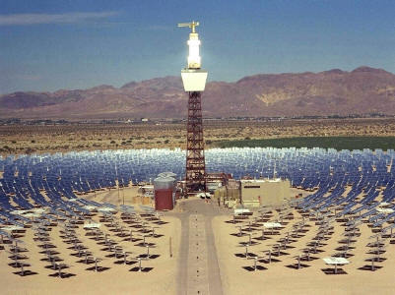
Solar Thermal
http://www.21stcentech.com/wp-content/uploads/2011/08/solar-thermal-9-storage-capacity.jpg

Slide 84
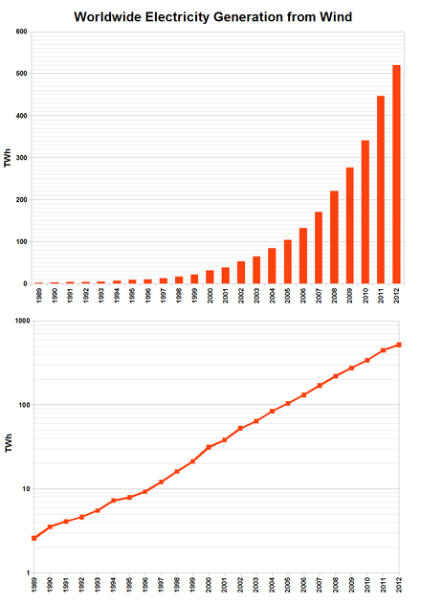
Worldwide Growth of Electricity Generation from Wind
http://en.wikipedia.org/wiki/Wind_power

Slide 85
Main Barriers for Renewable Energy
Intermittence (wind, solar, wave, tidal, etc.)
Unpredictability or poor predictability.
Diffuseness or low energy density
(e.g. daily average solar insolation in India ~ 4-7 KWh/m²)
Lack of efficient and environmentally acceptable large-scale energy storage.
E.g. batteries are not practical for a very large scale and most battery materials are harmful to the environment.

Slide 86
Main Barriers for Renewable Energy
Commercial and governmental policy factors make it difficult for any alternative energy form to compete.
e.g. government subsidies and support for conventional energy (fossil fuels and nuclear).
Fossil-fuel subsidies ($550 bi. in 2013) – more than four-times those to renewable energy – are holding back investment in efficiency and renewables. --World Energy Outlook 2014
Socio-environmental costs of conventional energy forms are not internalized.
i.e. the price we pay for it does not include the socio-environmental damage it causes.

Slide 87
Main Barriers for Renewable Energy
Poor grid capability to handle high variability of renewables.
Better wind and weather prediction models; more locations and hourly prediction.
Limited capability of infrastructure to enable inter-state transfers.
Smart-grids to enable load balancing.

Slide 88
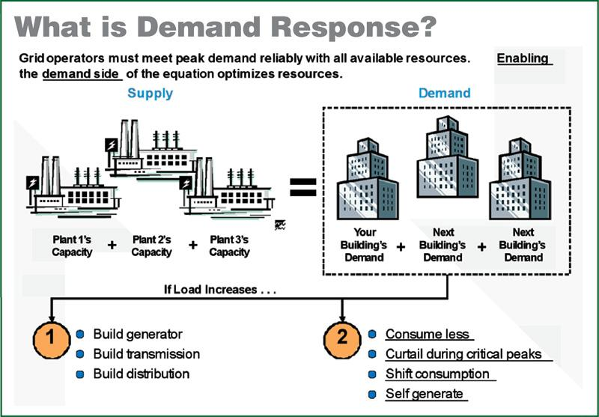
http://esm.versar.com/pprp/ceir15/images/Box_4c.jpg

Slide 89
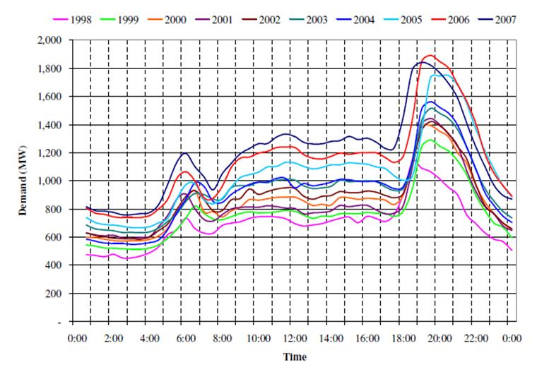
Daily Load Curve
http://2.bp.blogspot.com/-U2QR-p1gmgg/UWJSnefKJTI/AAAAAAAAHas/0pSiyLK4i1k/s1600/Electricity_Daily_Load_Curve_upto_2007_Sri_Lanka_Consumer_Electricity_Tariff_Need_is_for_a_Long_Term_Vision_Eng_Parakrama_Jayasinghe.JPG

Slide 90
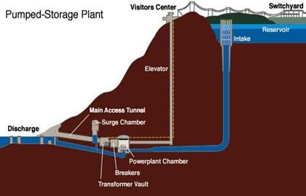
Need For Utility-Scale Storage
https://wattsupwiththat.files.wordpress.com/2014/07/clip_image0051.jpg
http://www.21stcentech.com/wp-content/uploads/2011/08/solar-thermal-9-storage-capacity.jpg
Round-trip energy efficiency: 70-80%
https://en.wikipedia.org/wiki/Pumped-storage_hydroelectricity
Watch Video:: Pumped Energy Storage (2.29min)
Watch Video: Solar thermal with storage (1.27 min)

Slide 91
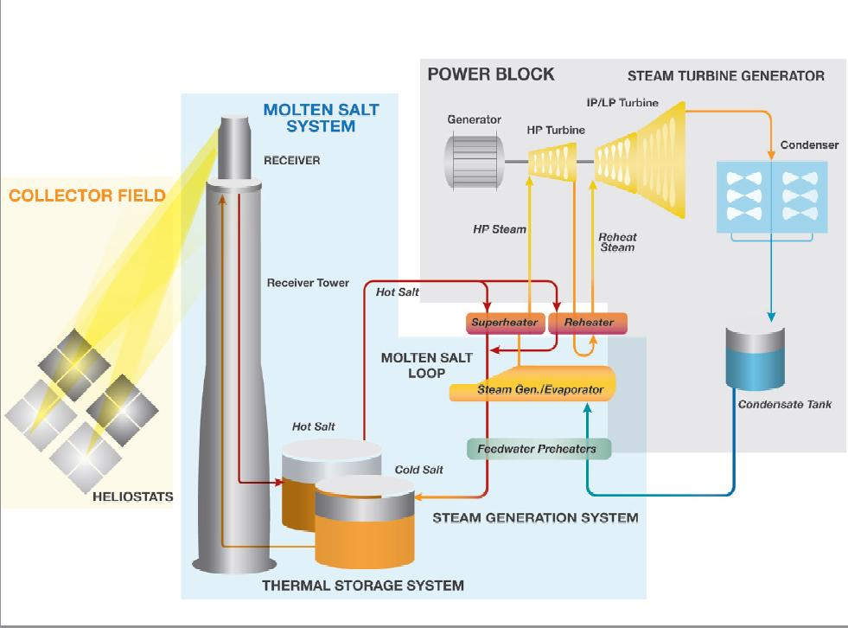
Solar Thermal Energy With Storage
http://www.csp-world.com/news/20130201/00728/store-or-not-store-not-question-anymore
http://www.csp-world.com/news/20130201/00728/store-or-not-store-not-question-anymore

Slide 92
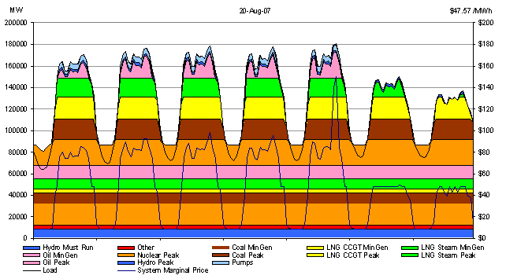
http://www.energyconsultants.com.au/images/International_Energy_Consultants_Graph3.gif

Slide 93
Smart Grid
Integration of digital processing and communications with the power grid.
Requires transformation in three areas:
improvement of infrastructure
addition of the digital layer
business process transformation
Feature:
Improved fault detection and self-healing
Flexibility in enabling bidirectional flows and distributed generation
Efficiency
Load adjustment/Load balancing
Peak curtailment/leveling
time of use pricing

Slide 94
Smart Grid
Smart grid is essential for allowing large amounts of renewable electricity on the grid.
Can accommodate highly variable renewable energy sources such as solar power and wind power.
Need to upgrade infrastructure to enable distributed generation.
Fluctuations in distributed generation (due to weather) need to be stabilized by varying the output of the more controllable generators such as gas turbines and hydroelectric generators.
Reading: 3 Ways Wind and Solar Can Continue To Grow In a 21st-Century Grid by Dyson et al.

Slide 95
Bioenergy
Bioenergy can form an important component in the overall renewable energy infrastructure.
Especially useful for biofuel production.
Need caution:
All renewable biomass cannot be used!
Energy crops should not be grown on food cropland.
Biomass for fuel should not be obtained from natural vegetation of natural habitats.
Agro-wastes and residues are potential fertilizers in food production. Their diversion for fuel production can deplete soil fertility.
Planted and sustainably managed energy forests and judicious use of agro and urban waste alone should be used for biofuel production.

Slide 96
Bioenergy Technologies
Direct combustion
Pyrolysis:
solid (char) fuel briquettes
liquid fuel (pyrolysis oil)…may need upgradation
Biomass gasification: synthesis gas (CO + H₂)
Steam reformation: producer gas (CO + H₂)
Biodiesel (transesterification of bio-derived) oils
Biodigestion/Fermentation
Biogas (bio-methanation) can be sustainable since it gives energy while simultaneously yielding the waste slurry with fertilizer value.
Bioethanol

Slide 97
Watch Video: MIT Algae Photobioreactor (5 min)
Innovative experimental system provides multiple benefits:
CO₂ emission reduction
CO₂ enhances biomass growth
NO_{x} removal
Solar Energy Utilization
Food/Fuel production

Slide 98
So What Have We Understood Sofar?
All the major conventional sources of energy have unacceptably high environmental and social impacts.
There is an urgent need for environmentally benign alternatives.
Solar, wind, geothermal, bioenergy and others are abundant.
Important barriers exist:
Technological: Intermittence, poor predictability diffuseness and lack of large-scale storage.
Others: Inadequate grid infrastructure, subsidies to fossil fuels and nuclear, inadequate political will.
A sudden transition is impossible; technologies and approaches are evolving.
For now, some amout of conventional sources will be required to meet the demand, but they must be gradually phased out.

Slide 99
Energy saved is energy generated!
Until then we must immediately and drastically reduce current energy use.
Managing demand is as important as managing supply.
Conscious consumption of direct energy and products (embodied energy) and avoiding waste.
Designing processes, products and our lifestyles to need less energy is crucial.

Slide 100
Outline
Units and Terms
Energy Resources, Depletion and Risks
Environmentally Benign Forms of Energy
Efficiency Measures
Reduction in Consumption—Individual Perspective

Slide 101
Choosing Where to Implement Efficiency Measures?
Need to analyze the energy consumption by source (coal, oil, etc.) and sector (industry, residential, etc.)
For max. benefit, identify the most energy-intensive end-uses and:
Replace or supplement conventional energy with economical and environmentally benign technologies (solar, wind) wherever possible.
Employ energy conservation and efficiency methods that lead to drastic advantages. e.g. heat integration.

Slide 102
World Energy Usage: By Sector 2009
S. No. | Sector (Trillion BTU) | Primary | Total | % of Total
1. | Industrial | 18571 | 28199 | 29.1
2. | Residential | 6606 | 21207 | 22.4
3. | Transportation | 26950 | 27033 | 28.5
4. | Commercial | 3974 | 18147 | 19.1
5. | Electric Power Sector | 38304
 | TOTAL |  | 94578 | 100
Primary energy: Energy in the form that it is first accounted for in a statistical energy balance, before any transformation to secondary or tertiary forms of energy. For example, coal can be converted to synthetic gas, which can be converted to electricity; in this example, coal is primary energy, synthetic gas is secondary energy, and electricity is tertiary energy.
http://tonto.eia.doe.gov/merquery/mer_data.asp?table=T02.01

Slide 103
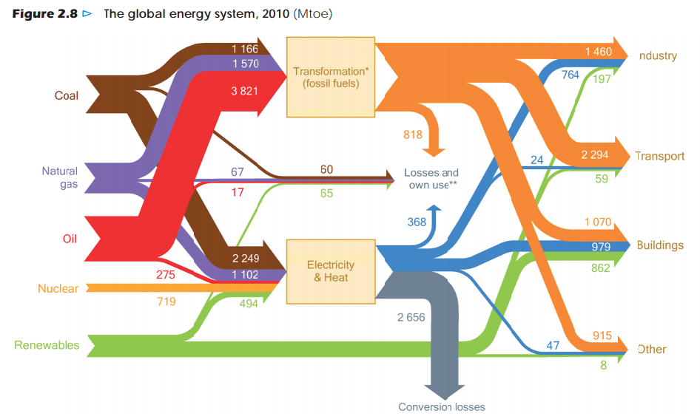
19%
19%
23%
8%
31%
Graphic: IEA, World Energy Outlook 2012
All losses

Slide 104
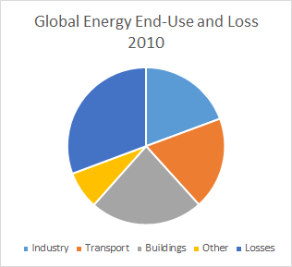
Electricity Generation: 38% of global primary energy use in 2010
Based on: IEA, World Energy Outlook 2012

Slide 105
Energy in everything we buy
Industry is the largest energy-consuming sector.
So, industry must be the focus of energy conservation efforts.
Manufacturing our vehicles, buildings, appliances, and even our food and clothes.
Embodied energy: energy invested in a particular thing during its lifetime, from cradle to grave.
Simply buy less and save energy!
Buy products with low embodied energy, high durability and only when necessary.
Reuse or recycle old products.

Slide 106
But the manufacturing industry is essential and must go on....
So, let's see how to reduce industry's energy use.
Which are the most energy-intensive industries?
Process industries

Slide 107
Solar Energy for Heating/Cooling in the Process Industry
Solar thermal energy is a mature and cost-competitive technology
Steam generation or process heating using concentrating solar technology
Will require a backup conventional heating module due to intermittence of solar energy.
Solar energy for cooling can be a viable option. Two approaches:
Pair a photovoltaic array with a standard compression cycle based chillers.
Pair a solar thermal collector with an absorption chiller

Slide 108
Heat Integration
100°C
60°C
H1
HE
50°C
HE
40°C
C1
Using the waste (or excess) heat from one product stream to heat another stream.
HE is a heat exchanger.

Slide 109
Heat Integration
Typical energy saving 15 – 45 %
Very general – easily applicable in Power generation, Oil refining, Petrochemicals, Food and Drink Industry, Pulp & Paper, hospitals etc.
Typical pay-back periods from a few weeks to 16 months (decision made by the client)
Considerably contributes to Emissions Reduction including CO₂
http://www.google.com/url?sa=t&source=web&cd=2&ved=0CB0QFjAB&url=http%3A%2F%2Fwww.cpi.umist.ac.uk%2Feminent%2FConfidential%2Fmeeting%2FRigaMeeting%2FRiga%2520Workshop%2FMarch%252008%2520Jiri%2520Klemes.ppt&ei=0shkTI6tJM-jcdGf8N4K&usg=AFQjCNHWPipjaJj_Uy4LGn57slZj3-fnZQ&sig2=KOve0TJ9NsWdy_p-O2li2A

Slide 110
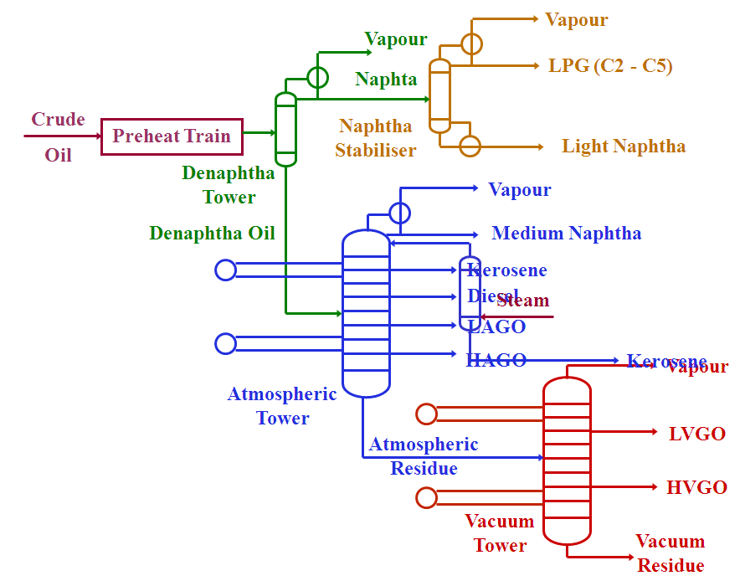
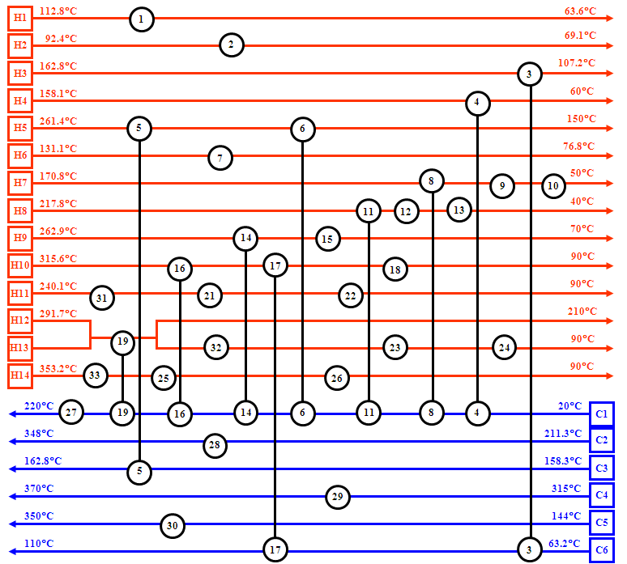
http://www.google.co.in/url?sa=t&rct=j&q=&esrc=s&source=web&cd=1&cad=rja&ved=0CCAQFjAA&url=http%3A%2F%2Fwww.cpi.umist.ac.uk%2Feminent%2FConfidential%2Fmeeting%2FRigaMeeting%2FRiga%2520Workshop%2FMarch%252008%2520Jiri%2520Klemes.ppt&ei=CGpdUMzoKsL3rQeN1YDICQ&usg=AFQjCNHWPipjaJj_Uy4LGn57slZj3-fnZQ&sig2=5FS9Tb5GfzED1S5-EDtHDg

Slide 111
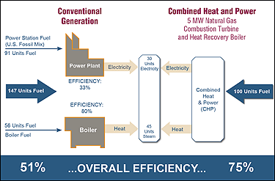
CHP
http://www.epa.gov/chp/basic/methods.html
Notes:
In this example of a typical CHP system, to produce 75 units of useful energy, the conventional generation or separate heat and power systems use 147 units of energy—91 for electricity production and 56 to produce heat—resulting in an overall efficiency of 51 percent. However, the CHP system needs only 100 units of energy to produce the 75 units of useful energy from a single fuel source, resulting in a total system efficiency of 75 percent.

Slide 112
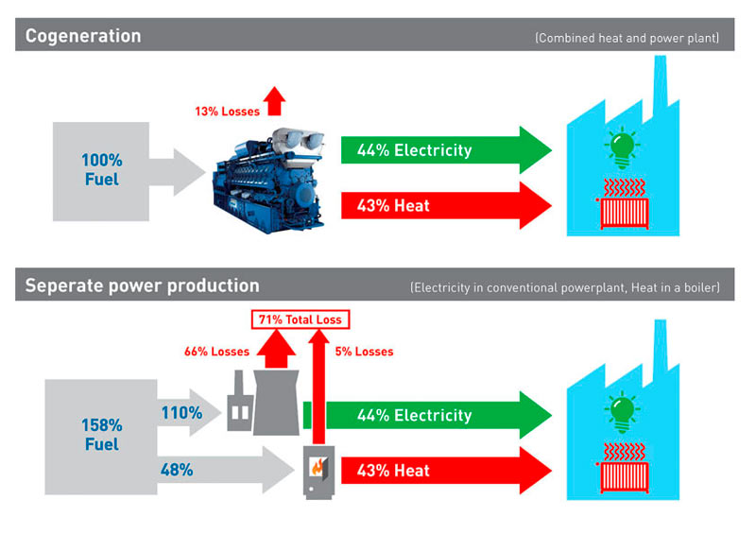
CHP
http://www.mwm.net/mwm-chp-gas-engines-gensets-cogeneration/mwm-competencies/cogeneration-trigeneration-plants/

Slide 113
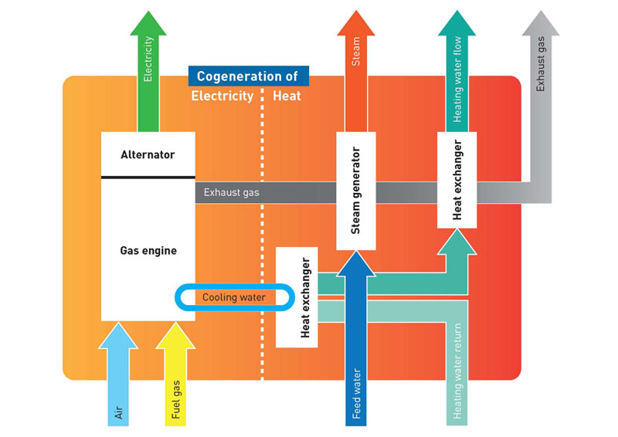
Working of CHP
http://www.mwm.net/mwm-chp-gas-engines-gensets-cogeneration/mwm-competencies/cogeneration-trigeneration-plants/

Slide 114
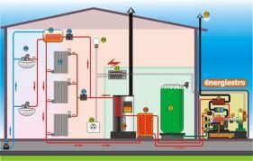
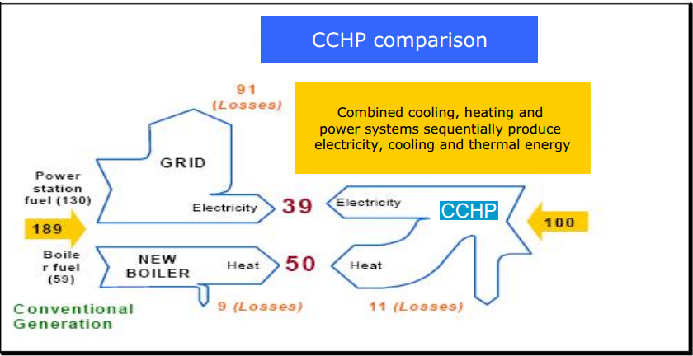

Slide 115
There are many ways to basically reduce our domestic energy use.
One such is green roofs:
Reduced building heat gain.
Evaporative cooling
Food production
Carbon absorption
Possibilities for greywater recycling

Slide 116
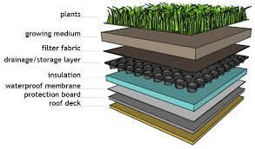
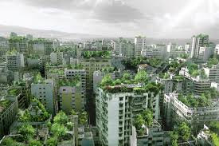

Green Roofs
https://www.google.co.in/search?es_sm=93&biw=1024&bih=462&tbm=isch&q=intensive+green+roofs&revid=96988145&sa=X&ei=j_gSVaq3JYPjuQS-0oHwBA&ved=0CCQQ1QIoAg#imgdii=_&imgrc=uHeWo9iMQU22FM%253A%3BLTQDjMUyl5p9EM%3Bhttp%253A%252F%252Fgreengarage.ca%252Fimg%252Fexploded-layers.gif%3Bhttp%253A%252F%252Fgreengarage.ca%252Fgreenroofs%252Ffeatures.php%3B613%3B360
https://www.google.co.in/search?es_sm=93&biw=1024&bih=462&tbm=isch&q=green+roof+house&revid=96988145&sa=X&ei=j_gSVaq3JYPjuQS-0oHwBA&ved=0CB4Q1QIoAA#imgrc=JyOGiVdf0bwmSM%253A%3BxVNV-gsZV1bN5M%3Bhttp%253A%252F%252Fwww.powerhousegrowers.com%252Fwp-content%252Fuploads%252F2014%252F02%252Fvilla-bio-spain-green-roof-home.jpg%3Bhttp%253A%252F%252Fwww.powerhousegrowers.com%252Fgreen-roofs-101-what-is-a-green-roof-and-what-does-it-do%252F%3B750%3B514
https://www.google.co.in/search?es_sm=93&biw=1024&bih=462&tbm=isch&q=green+roofs+city&revid=96988145&sa=X&ei=j_gSVaq3JYPjuQS-0oHwBA&ved=0CCEQ1QIoAQ#imgdii=_&imgrc=evlyO0nMmWjZZM%253A%3BFY8zA1TjpKbXyM%3Bhttp%253A%252F%252Fcdni.wired.co.uk%252F620x413%252Fa_c%252FBWF-00.jpg%3Bhttp%253A%252F%252Fwww.wired.co.uk%252Fnews%252Farchive%252F2012-01%252F04%252Fbeirut-wonder-forest%3B620%3B413

Slide 117
Earthships 101 part I (5.21 min)
Earthships 101 part II (6.47min)

Slide 118
Outline
Units and Terms
Energy Resources, Depletion and Risks
Environmentally Benign Forms of Energy
Efficiency Measures
Reduction in Consumption—Individual Perspective

Slide 119
What Can Chemical Engineers Do?
Industrial Symbiosis
Process Integration, Pinch Technology
Cogeneration: CHP, CCHP
Heat Integration, Waste Heat Recovery
Pyrolysis: gasification, liquid fuel, biomass utilization, plastic waste-to-energy, etc.
Biomethanation (biogas)
Biofuels
Green Chemistry
Plastics recycling
Natural polymers and composites
Environmental remediation, Waste treatment

Slide 120
What Can Mechanical Engineers Do?
Cogeneration: CHP, CCHP
Heat Integration, Waste Heat Recovery
Industrial Symbiosis Networks
Automotive efficiency improvement
Use engine waste heat for air conditioner (absorption chiller)
Convert engine waste heat to electricity (thermoelectric devices) and change battery.

Slide 121
What Can Materials Scientists Do?
Photovoltaics:
organic photovoltaics
semiconductors, quantum dots, etc.
Dyes, electrolytes,
LEDs
Nanostructured catalysts:
for degradation of toxics, gas-to-liquid,
Ultracapacitors
Sensors
Fuel Cells: membranes, catalysts, etc.
Batteries: economical, high energy and power density, low toxic, rechargeable/refurbishable?

Slide 122
What Can Consumers Do?
Minimize the purchase of new appliances and gadgets, clothes, and products. Repair and reuse old ones.
Avoid air conditioners. Prefer fans or desert coolers.
Minimize waste of electricity by turning of lights (CFL/LED) , fans and appliances, (unplug when not in use)
Keep computer in shutdown or hibernate modes when not in use.
Build an ecohouse: green materials and architecture, daylighting, passive heating/cooling concepts, integrated energy systems, rainwater harvesting, water recycling, dry composting toilets, backyard/terrace/balcony food gardens

Slide 123
What Can Consumers Do?
Walk or use bicycles for short distances and public transportation or two-wheelers for longer distances.
Avoid air travel and purchasing private cars.
Purchase essential products grown/produced in the 5, 50, 100 km radius. Low product miles and low embodied energy.
Use cloth bags and old containers for shopping. Avoid disposable plastic bags.
Use reusable plates, cups and silverware. Avoid paper/plastic
Calculate your carbon and ecological footprint and try to minimize it.

Slide 124
What Can Consumers Do?
Conserve LPG while cooking.
Use solar heaters to heat water.
Minimize the use of paper
Adopt alternative medicines (e.g. homeopathy) for minor ailments (pharmaceutical industry consumes a lot of energy)
Be vegetarian! Vegetarian food consumes far less water, energy and is better for your health!
Avoid processed foods.

